Slide 1


Vitali Babich
2022-06-03
Notes:
done

Slide 2

Outline
Executive Summary
Introduction
Methodology
Results
Conclusion
Appendix
Notes:
Done

Slide 3
Executive Summary
Used methodologies
Data collected by API and web-scrapping
Data visualization by line, bar, scatter charts
Spatial data visualization
Used Logistic Regression, SVM, Decision Tree, KNN methods
Summary of all results
SpaceX are increasing success rate of the launching
Part of the orbits are problem for SpaceX
Notes:
Done

Slide 4
Introduction
This report is a part of the Applied Data Science Capstone
Problems I want to find answers
Is the launching success rate increasing or decreasing?
Which criteria influence to success rate and which don’t?
Can we predict success of the landing
Notes:
Done

Slide 5

Section 1
Notes:
Do not need

Slide 6
Methodology
Executive Summary
Data collection methodology:
Data was collected from coursera tasks, web scaping, using REST API
Perform data wrangling
Data was processed using pandas functions
Perform exploratory data analysis (EDA) using visualization and SQL
Perform interactive visual analytics using Folium and Plotly Dash
Perform predictive analysis using classification models
Split data to train and test sets, standardize data
Build models (LogisticRegression, Decision Tree, SVM, KNN)
Choose the best model
Notes:
done

Slide 7
replace np.nan values in the data with the mean
Data Collection
REST API
Request to the SpaceX API
Clean the requested data
Replace missing values of PayloadMass with mean value
Web scrapping
Get data from html page from Wikipedia (https://en.wikipedia.org/w/index.php?title=List_of_Falcon_9_and_Falcon_Heavy_launches&oldid=1027686922)
Get tables and convert them to pandas DataFrame

Slide 8
Data Collection – SpaceX API
Data collection by using functions get of the requests module.
https://github.com/vitalyvb1974/ds/blob/main/jupyter-labs-spacex-data-collection-api.ipynb
Response = requests.get()
json = Response.json()
spacex_df = pandas.json_normalize(json)
For by nested lists and call API for BustedVersion
For by nested lists and call API for Core
For by nested lists and call API for PayloadData
For by nested lists and call API for LaunchPad
Filter and enrich data
Notes:
done

Slide 9
Data Collection - Scraping
Scraping process includes receiving html page by function get of the requests module, parse it by methods of soup object (BeautifulSoup module), create dataframe from dict
https://github.com/vitalyvb1974/ds/blob/main/jupyter-labs-webscraping.ipynb
Response = requests.get()
soup = BeautifulSoup( Response.text )
Get tables by soup.find_all( "table“ )
Extract column names
Create dictionary with table’s data
Create DataFrame from dictionary
Notes:
done

Slide 10
Data Wrangling
Determine the number and occurrence for fields LaunchSite, Orbit, Outcome by value_counts()
Create landing outcome labels (by comprehensive list) and add them to new column into dataframe
https://github.com/vitalyvb1974/ds/blob/main/labs-jupyter-spacex-Data%20wrangling.ipynb
pandas.read_csv
Calculate numbers by fields
Create a landing outcome label
Add labels as new column “Class”
Calc mean of Class column
Notes:
done

Slide 11
EDA with Data Visualization
Scatter plot to visualize the relationship between parameters (Payload vs. Orbit type, FlightNumber vs. Orbit type, Payload vs. Launch Site, Flight Number vs. Launch Site, FlightNumber vs. PayloadMass)
Bar chart to visualize the mean value of the parameters (success rate of each orbit type)
Line chart to visualize the mean the trend of the parameter (launch success yearly trend)
https://github.com/vitalyvb1974/ds/blob/main/jupyter-labs-eda-dataviz.ipynb

Slide 12
EDA with SQL
I used SQLite database
SQL queries are used to get distinct launch sites, 5 launch sites by pattern name, aggregate sum of the payload mass (in kg), average payload mass for distinct booster version, date of the first successful landing outcome, booster version with range of payload mass, total count of success and failed outcomes, booster version with max payload mass by sql subquery, list of failed landing_outcomes in drone ship and Rank the count of landing outcomes
https://github.com/vitalyvb1974/ds/blob/main/jupyter-labs-eda-sql-coursera.ipynb
Notes:
done

Slide 13
Build an Interactive Map with Folium
I used folium.map object, and folium.Circle, folium.map.Marker, folium.plugins.MarkerCluster, folium.plugins.MousePosition, folium.features.DivIcon, folium.PolyLine, folium.Icon
These objects are used to add a highlighted circle area to map (text and with a icon showing its name) (Circle and Marker), to simplify a map containing many markers having the same coordinate (MarketCluster), to specify icon (DivIcon and Icon), to add line (PolyLine), to get coordinate for a mouse over a point on the map (MousePosition)
https://github.com/vitalyvb1974/ds/blob/main/lab_jupyter_launch_site_location.ipynb
Notes:
Done

Slide 14
Build a Dashboard with Plotly Dash
I have added:
Dropdown (to enable Launch Site selection) and rangeslider (to select payload range) interactions
Pie chart (to show the total successful launches count for all sites) and scatter plot (to visualize relationship between parameters)
I select these visualizations because there accordance to goal like site selection, range selection, showing relation, showing total values
https://github.com/vitalyvb1974/ds/blob/main/dashboard01.py
Notes:
done

Slide 15
Predictive Analysis (Classification)
I create Logistic Regression (LR), SVM, DecisionTree, KNN objects. Use GridSearchCV object with different parameters to find the best model (the best combination of parameters). Then models have been evaluated by test set.
Process consists of loading data set, slitting it to train and test parameters, create objects and fit them with train data. Get score by test data.
https://github.com/vitalyvb1974/ds/blob/main/SpaceX_Machine%20Learning%20Prediction_Part_5.ipynb
pandas.read_csv
Create model and GridSearchCV objects
Fit object
Get best model parameters
Calculate score and confusion matrix
Notes:
done

Slide 16
Results
Exploratory data analysis results
Interactive analytics demo in screenshots
Predictive analysis results

Slide 17

Section 2

Slide 18
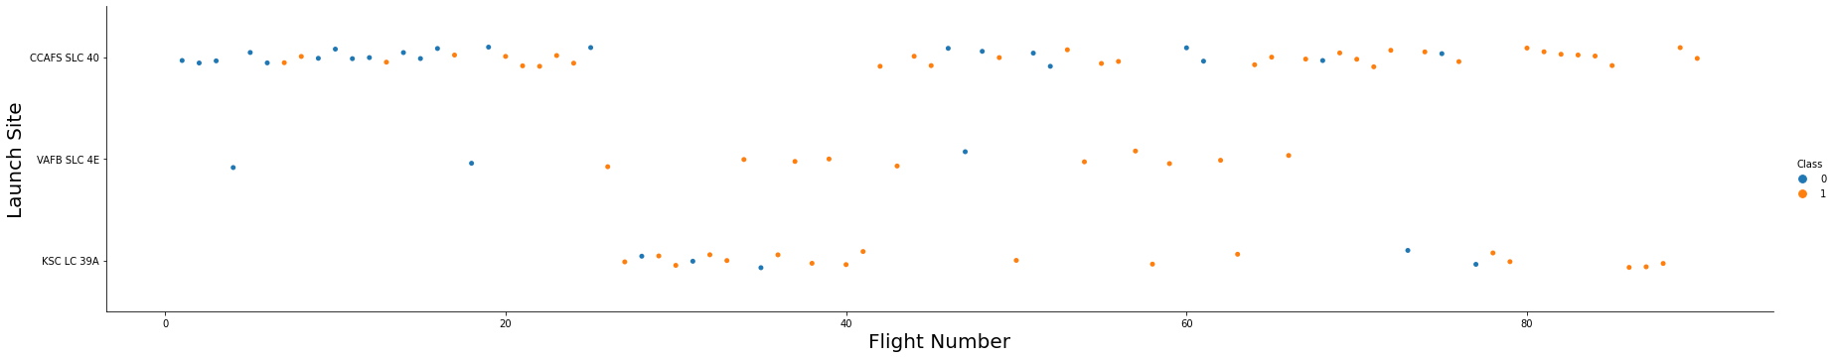
Flight Number vs. Launch Site
Flight Number vs. Launch Site scatter plot
Most of the landing on the CCAFS SLC 40 at the first stage was failed. Success rate increased after about 20 flight number.
Notes:
done

Slide 19
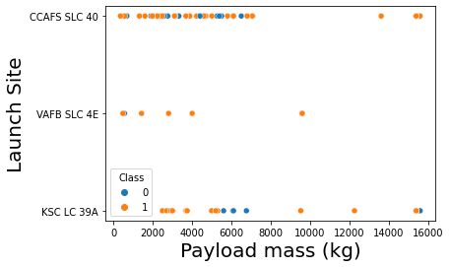
Payload vs. Launch Site
A scatter plot of Payload vs. Launch Site
CCAFS SLC 40 more suitable for heavy payload
There are most of the problems with launches with payload between 4500 and 6500 kg
Notes:
done

Slide 20
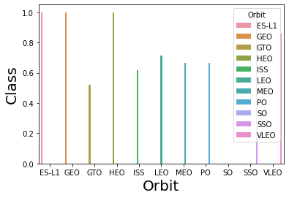
Success Rate vs. Orbit Type
A bar chart for the success rate of each orbit type
The least success rate is on the GTO orbit. So SpaceX cannot be used to launch geosynchronous spot for monitoring weather, communications and surveillance. The operator has to concentrate on increasing success rate on GTO orbit.
The best rate in ES-L1, GEO, HEO and SSO orbits.
Notes:
Done

Slide 21
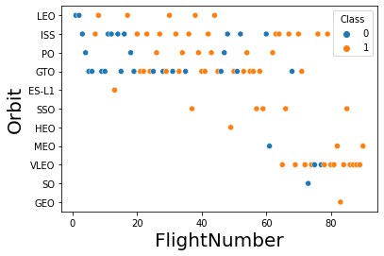
Flight Number vs. Orbit Type
A scatter point of Flight number vs. Orbit type
The Success appears related to the number of flights in the LEO orbit. But there is no relationship between flight number in GTO orbit.
Notes:
done

Slide 22
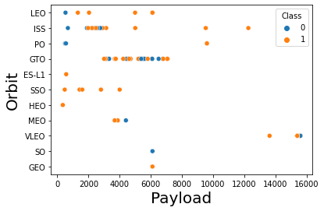
Payload vs. Orbit Type
A scatter point of payload vs. orbit type
With heavy payloads the successful landing or positive landing rate are more for Polar, LEO and ISS.
It seems, GTO success rate doesn’t relate with orbit.
Notes:
Done

Slide 23
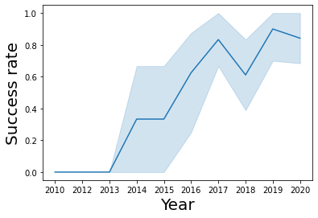
Launch Success Yearly Trend
A line chart of yearly average success rate
We can observe that the success rate since 2013 kept increasing till 2020 except 2018.
Notes:
Done

Slide 24
All Launch Site Names
Launch_Site
CCAFS LC-40
VAFB SLC-4E
KSC LC-39A
CCAFS SLC-40
Find the names of the unique launch sites
Present your query result with a short explanation here
select distinct launch_site from spacex;
SQL query select unique values of column.
Notes:
Done

Slide 25
Launch Site Names Begin with 'CCA'
Find 5 records where launch sites begin with `CCA`
Present your query result with a short explanation here
select * from spacex where launch_site like 'CCA%' limit 5;
Get values by pattern and limit result by 5 records.
Date | Time | Booster_Version | Launch_Site | Payload | PAYLOAD_MASS__KG_ | Orbit | Customer | Mission_Outcome | Landing_Outcome
2010-06-04 18:45:00 | 18:45:00 | F9 v1.0 B0003 | CCAFS LC-40 | Dragon Spacecraft Qualification Unit | 0 | LEO | SpaceX | Success | Failure (parachute)
2010-12-08 15:43:00 | 15:43:00 | F9 v1.0 B0004 | CCAFS LC-40 | Dragon demo flight C1, two CubeSats, barrel of Brouere cheese | 0 | LEO (ISS) | NASA (COTS) NRO | Success | Failure (parachute)
2012-05-22 07:44:00 | 07:44:00 | F9 v1.0 B0005 | CCAFS LC-40 | Dragon demo flight C2 | 525 | LEO (ISS) | NASA (COTS) | Success | No attempt
2012-10-08 00:35:00 | 00:35:00 | F9 v1.0 B0006 | CCAFS LC-40 | SpaceX CRS-1 | 500 | LEO (ISS) | NASA (CRS) | Success | No attempt
2013-03-01 15:10:00 | 15:10:00 | F9 v1.0 B0007 | CCAFS LC-40 | SpaceX CRS-2 | 677 | LEO (ISS) | NASA (CRS) | Success | No attempt
Notes:
Done

Slide 26
Total Payload Mass
Calculate the total payload carried by boosters from NASA
Total payload 45,596 kg
Payload by booster in the table
SQL query: select sum(payload_mass__kg_) from spacex where customer = 'NASA (CRS)’
Result:
Booster_Version | sum(payload_mass__kg_)
F9 B4 B1039.2 | 2647
F9 B4 B1039.1 | 3310
F9 B4 B1045.2 | 2697
F9 B5 B1056.2 | 2268
F9 B5 B1058.4 | 2972
F9 B5 B1059.2 | 1977
F9 B5B1050 | 2500
F9 B5B1056.1 | 2495
F9 FT B1035.2 | 2205
F9 FT B1021.1 | 3136
F9 FT B1025.1 | 2257
F9 FT B1031.1 | 2490
F9 FT B1035.1 | 2708
F9 v1.0 B0006 | 500
F9 v1.0 B0007 | 677
F9 v1.1 | 2296
F9 v1.1 B1010 | 2216
F9 v1.1 B1012 | 2395
F9 v1.1 B1015 | 1898
F9 v1.1 B1018 | 1952
sum(payload_mass__kg_)
45596
Notes:
done

Slide 27
Average Payload Mass by F9 v1.1
Calculate the average payload mass carried by booster version F9 v1.1
2928.4 kg
Present your query result with a short explanation here
SQL Query: select Booster_Version, avg(payload_mass__kg_) from spacex where Booster_version = 'F9 v1.1’
Result:
Booster_Version | avg(payload_mass__kg_)
F9 v1.1 | 2928.4
Notes:
Done

Slide 28
First Successful Ground Landing Date
Landing_Outcome | min(Date)
Controlled (ocean) | 2014-04-18 19:25:00
Failure | 2018-12-05 18:16:00
Failure (drone ship) | 2015-01-10 09:47:00
Failure (parachute) | 2010-06-04 18:45:00
No attempt | 2012-05-22 07:44:00
No attempt | 2019-08-06 23:23:00
Precluded (drone ship) | 2015-06-28 14:21:00
Success | 2018-07-22 05:50:00
Success (drone ship) | 2016-04-08 20:43:00
Success (ground pad) | 2015-12-22 01:29:00
Uncontrolled (ocean) | 2013-09-29 16:00:00
Find the dates of the first successful landing outcome on ground pad
2015-12-22
Present your query result with a short explanation here
SQL: select Landing_Outcome, min(Date) from spacex group by Landing_Outcome
Look at the row with landing_outcome = ‘Success (ground pad)’
Notes:
Done

Slide 29
Successful Drone Ship Landing with Payload between 4000 and 6000
Booster_Version | PAYLOAD_MASS__KG_
F9 FT B1022 | 4696
F9 FT B1026 | 4600
F9 FT B1021.2 | 5300
F9 FT B1031.2 | 5200
List the names of boosters which have successfully landed on drone ship and had payload mass greater than 4000 but less than 6000
SQL: select booster_version, payload_mass__kg_ from spacex where landing_outcome = 'Success (drone ship)' and payload_mass__kg_ > 4000 and payload_mass__kg_ < 6000;
Notes:
Done

Slide 30
Total Number of Successful and Failure Mission Outcomes
Calculate the total number of successful and failure mission outcomes
select sum(iif(landing_Outcome like '%Success%',1,0)) as success, sum(iif(lower(landing_Outcome) like '%failure%',1,0)) as failure from spacex;
Success landing more than failure.
success | failure
61 | 10
Notes:
done

Slide 31
Boosters Carried Maximum Payload
Booster_Version
F9 B5 B1048.4
F9 B5 B1049.4
F9 B5 B1051.3
F9 B5 B1056.4
F9 B5 B1048.5
F9 B5 B1051.4
F9 B5 B1049.5
F9 B5 B1060.2
F9 B5 B1058.3
F9 B5 B1051.6
F9 B5 B1060.3
F9 B5 B1049.7
List the names of the booster which have carried the maximum payload mass
Sql query with subquery:
select distinct booster_version from spacex where payload_mass__kg_ = (select max(payload_mass__kg_) from spacex);
A lot of type of booster have carried the maximum payload mass
Notes:
done

Slide 32
2015 Launch Records
he failed landing_outcomes in drone ship, their booster versions, and launch site names for in year 2015
Both of the launch site is CCAFS LC-40.
Landing_Outcome | Booster_Version | Launch_Site | year | Date
Failure (drone ship) | F9 v1.1 B1012 | CCAFS LC-40 | 2015 | 2015-01-10 09:47:00
Failure (drone ship) | F9 v1.1 B1015 | CCAFS LC-40 | 2015 | 2015-04-14 20:10:00
Notes:
Done

Slide 33
Rank Landing Outcomes Between 2010-06-04 and 2017-03-20
Landing_Outcome | count(landing_outcome)
No attempt | 10
Success (drone ship) | 5
Failure (drone ship) | 5
Success (ground pad) | 3
Controlled (ocean) | 3
Uncontrolled (ocean) | 2
Failure (parachute) | 2
Precluded (drone ship) | 1
Rank the count of landing outcomes (such as Failure (drone ship) or Success (ground pad)) between the date 2010-06-04 and 2017-03-20, in descending order
Result of the query ordered by count of landing outcome. The most occurred is “No attempt”
Notes:
done

Slide 34

Section 3

Slide 35
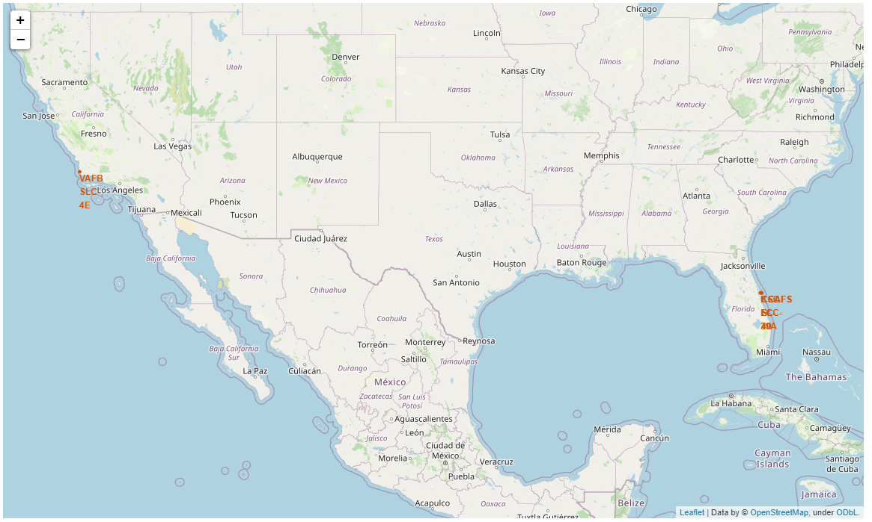
Launch sites
Notes:
done

Slide 36
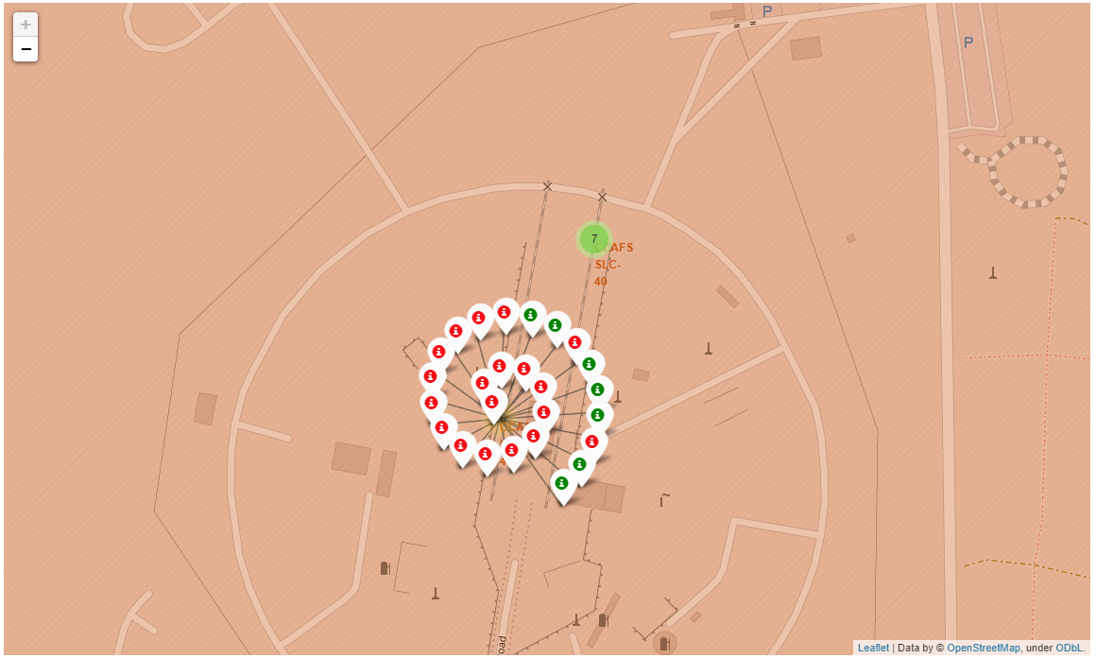
Launch outcomes
Notes:
done

Slide 37
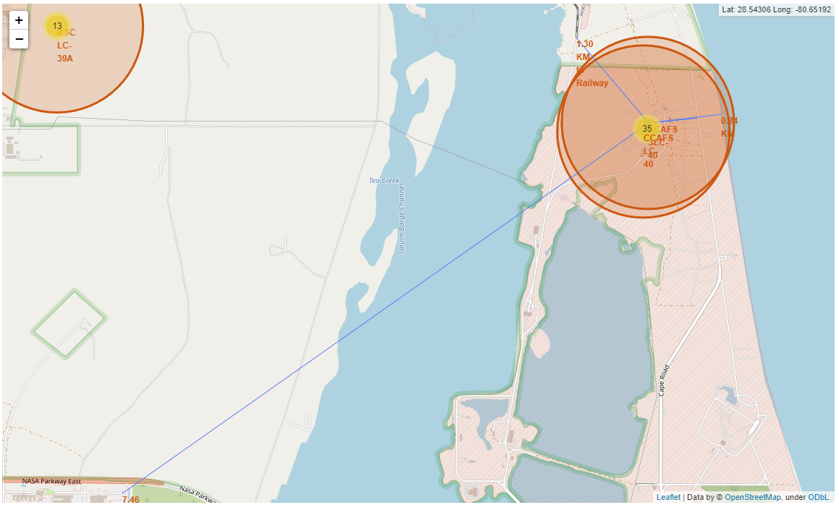
Distance to objects
Notes:
done

Slide 38

Section 4

Slide 39
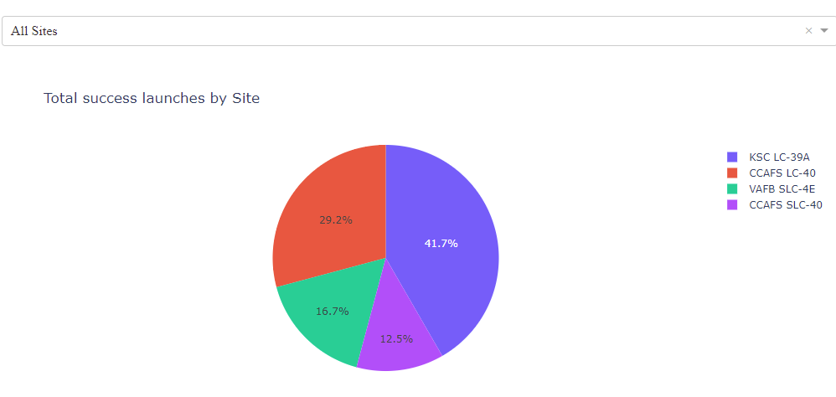
Total success launches by Site
The most success launches reached by KSC LC-39A site.
Notes:
done

Slide 40
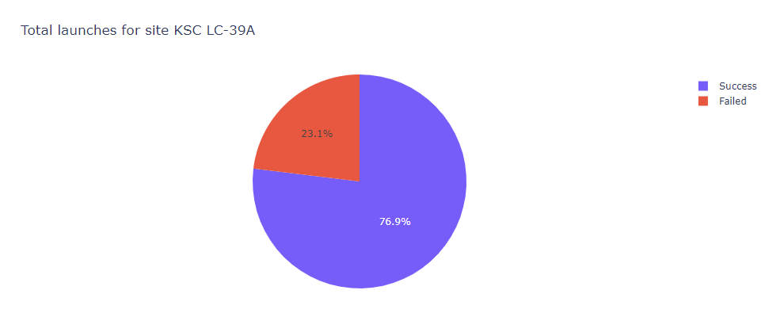
Success and failed launches by KSC LC-39A
Success rate is more than 76%
Notes:
done

Slide 41
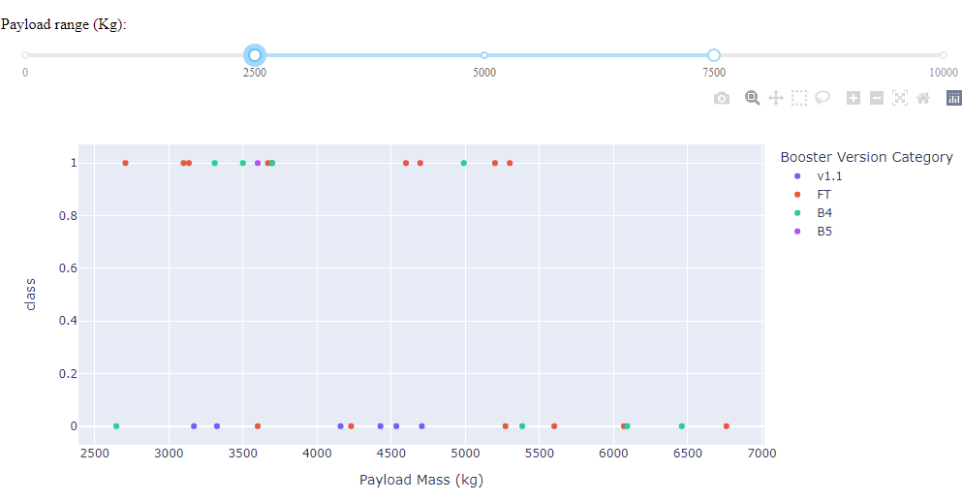
Payload vs. Launch Outcome in range 2500 to 7500 kg payload
FT and B4 have better success rate in compare with v1.1 and B5.
Notes:
Done

Slide 42

Section 5

Slide 43
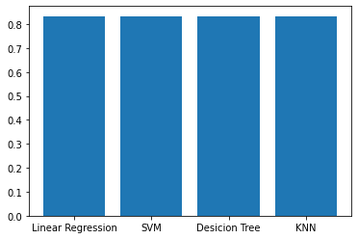
Classification Accuracy
Model accuracy for all built classification models, in a bar chart
All model show same accuracy on the test set

Slide 44
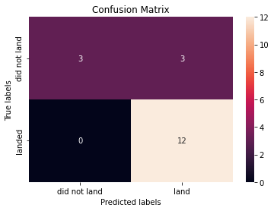
Confusion Matrix
All matrix have same view

Slide 45
Conclusions
SpaceX success rate has been increasing during the research period
GTO orbit is a problem orbit for SpaceX
All tasks of the final assignment have done
Different tools and methods of data analysis are used during final assignment
Type of visualization depends on goal of visualization

Slide 46
Appendix
Jupyter notebooks
https://github.com/vitalyvb1974/ds/blob/main/SpaceX_Machine%20Learning%20Prediction_Part_5.ipynb
https://github.com/vitalyvb1974/ds/blob/main/jupyter-labs-eda-dataviz.ipynb
https://github.com/vitalyvb1974/ds/blob/main/jupyter-labs-eda-sql-coursera.ipynb
https://github.com/vitalyvb1974/ds/blob/main/jupyter-labs-spacex-data-collection-api.ipynb
https://github.com/vitalyvb1974/ds/blob/main/jupyter-labs-webscraping.ipynb
https://github.com/vitalyvb1974/ds/blob/main/lab_jupyter_launch_site_location.ipynb
https://github.com/vitalyvb1974/ds/blob/main/labs-jupyter-spacex-Data%20wrangling.ipynb
Python code (dashboard)
https://github.com/vitalyvb1974/ds/blob/main/dashboard01.py
SQLite database file (used instead of IBM DB2)
https://github.com/vitalyvb1974/ds/blob/main/spacex_sqlite.db

Slide 47


